Slide 1
SSIS Introduction
René Moyzes
Lead BI Specialist
Tieto
rene.moyzes@tieto.co

Slide 2
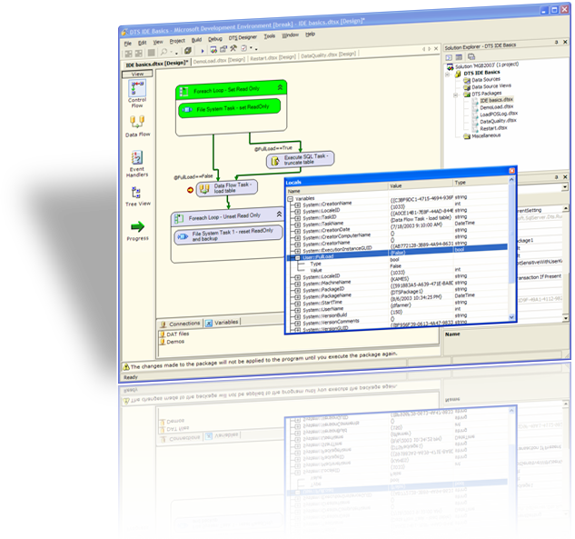
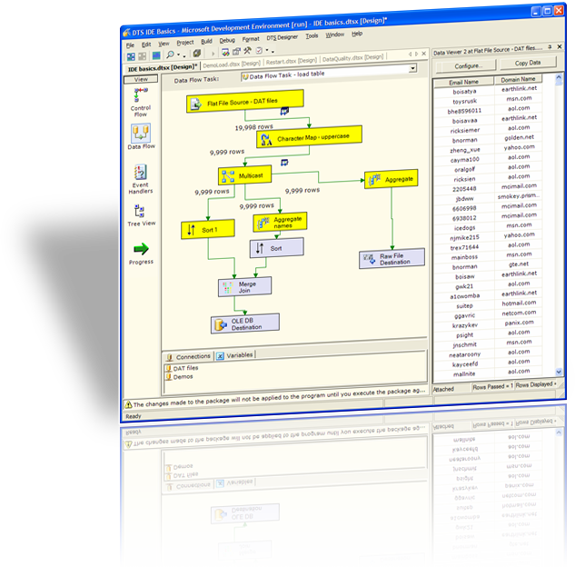
Integration Services Why ETL Matters
Merge data from heterogeneous data stores:
Text files
Mainframes
Spreadsheets
Multiple RDBMS
Refresh data in data warehouses and data marts
Cleanse data before loading to remove errors
High-speed load of data into online transaction processing (OLTP) and online analytical processing (OLAP) databases
Build BI into a data transformation process without the need for redundant staging environments
Lots more ☺

Slide 3




SSIS Overview
Data sources can be diverse, including custom or scripted adapters
Transformation components shape and modify data in many ways.
Data is routed by rules or error conditions for cleansing and conforming.
Flows can be as complex as your business rules, but highly concurrent.
And finally data can be loaded in parallel to many varied destinations.

Slide 4
Data Sources
Data Sources
Excel
Common problem - not all data coming through correctly
By Default Excel will determine the column types based on a “Majority Type” rule.
Overcome this by forcing a type in the Data connector

Slide 5
Data Sources Continued
Data Sources
Verifying Connectivity / Availability
ETL Tasks run through some of the steps and then fail on connectivity issues.
Why Would you want to check for this?
Use scripting task.

Slide 6
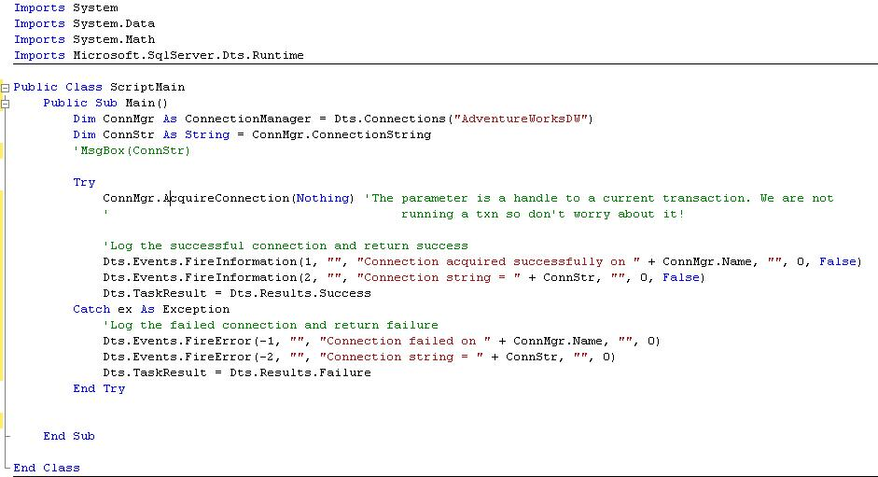
Scripting

Slide 7
Data Sources Continued
Data Sources
OLE DB Provider
Selecting Table or View dropdown as a source.
So what is the problem with this?
Replace with what
Select * from [TABLENAME] – not much better or is it?
Select [field list] from [TABLENAME] – resource usage

Slide 8
OLE DB Provider
If a table is selected
SSIS issues an OPENROWSET
If a SQL statement is used
SSIS issues sp_executesql.

Slide 9
Sourcing Data
Common Requirement
Get all Data from one table that does not exist in another
Get all rows from a staging table where the business key is not in the dimension table
Conventional T-SQL
Using SSIS

Slide 10
Sourcing Data Conventional T-SQL
INSERT INTO DIM_DATE
SELECT s.* FROM STG_DATE s
LEFT OUTER JOIN DIM_DATE d
ON s.DateID = d.DateID
WHERE d.DateID IS NULL
INSERT INTO DIM_DATE
SELECT s.* FROM STG_DATE s
WHERE DateID NOT IN (SELECT DISTINCT DateID
FROM DIM_DATE d)

Slide 11
Sourcing Data Using SSIS
Merge Join
Same as first T-SQL Statement
Requires a Sort and Conditional Split
Lookup
Using the SSIS functionality.
Less Coding
Uses the error output as the valid records.
Speed Comparisons

Slide 12
Lookups
Exact Matching
Want data that matches a specific field.
Normal usage of Lookup
Range Comparisons
Want data that falls between 2 values
The Caching SQL Statement
Mapping of Parameters

Slide 13
High-end 32 bit performance
The test included parsing a text file and passing through 7 transformations
The graph shows throughput of 17Gb/Hr
Parallelism is one of the keys to performance on 32-bit.

Slide 14
What does 64-bit enable?
Increased memory capacity enables very high performance components
But some Integration Services components benefit more than others
High performance Integration Services components enable new warehouse architectures
Especially load balancing between the integration process and the warehouse server

Slide 15




Components in the data flow
Some components work with data row by row
Calculating new columns
Converting data
Character conversions
Look-up joins to reference tables
These benefit more from parallelism than memory

Slide 16

Components in the data flow
Some components need to work with the entire data set
Aggregation
Sorting
Fuzzy (best match) Lookups and Deduplication
These benefit from increased memory
64 bit enables potentially huge data sets to be worked on in memory

Slide 17
An example 64-bit benefit: Lookups
Lookups involve matching incoming values to a reference database
3 types of lookups:
Cached – the reference set is cached in memory
Partial cache – the cache is built up as lookups are found
No cache – every lookup needs a roundtrip to the reference database
32-bit cache size is memory-constrained
64-bit cache size could cache the largest reference sets

Slide 18









Enabling new architectures …
Traditional warehouse loading
In this traditional scenario, the integration process simply conforms data and loads the database server
The database performs aggregations, sorting and other operations …
… but has to contend with competing demands for resources from user queries
This solution does not scale to very large volumes of data and multiple, complex aggregations

Slide 19

Enabling new architectures …
Warehouse loading with SQL Server Integration Services
Here, SQL Server Integration Services conforms the data as before …
… but also aggregates and sorts, and loads the database
This frees-up the database server for user queries
With 64-bit this solution scales well to very large volumes of data and multiple, complex aggregations
Even with 32 bit, this architecture can be scaled-out to use a separate box for the integration process

Slide 20
Customer benefits of SSIS
Performance
Data flows process large volumes of data efficiently - even through complex operations
Facility
Many prebuilt adapters and transformations reduce hand coding
Extensible object model enables specialized custom or scripted components
Highly productive visual environment speeds development and debugging
“Smarts”
Data cleansing features enable difficult data to be handled during loading
Data mining brings intelligent handling of data for imputation of incomplete data, conditional processing of potential problems, or smart escalation of issues such as fraud detection

Slide 21
Some Performance Tuning Tips
Only Select the Columns that you need
Use a SQL Server Destination instead of an OLE DB Destination
If using an OLE DB Destination – use the table or view with fast load data access mode.
Use standardized naming conventions
Where possible, filter your data in the Source Adapter rather than using a Conditional Split transform component
LOOKUP components will generally work quicker than MERGE JOIN components where the 2 can be used for the same task
Use caching in your LOOKUP components where possible. It makes them quicker. Just watch that you are not grabbing too many resources.
Use Sequence containers to organize package structure into logical units of work.

